Slide 1
AGILE METHODOLOGY
MALATHI V
(2081139)

Slide 2



Agenda
What is Agile
Advantages and Disadvantages
What is scrum & scrum Team
Scrum Terminology
Sprint

Slide 3
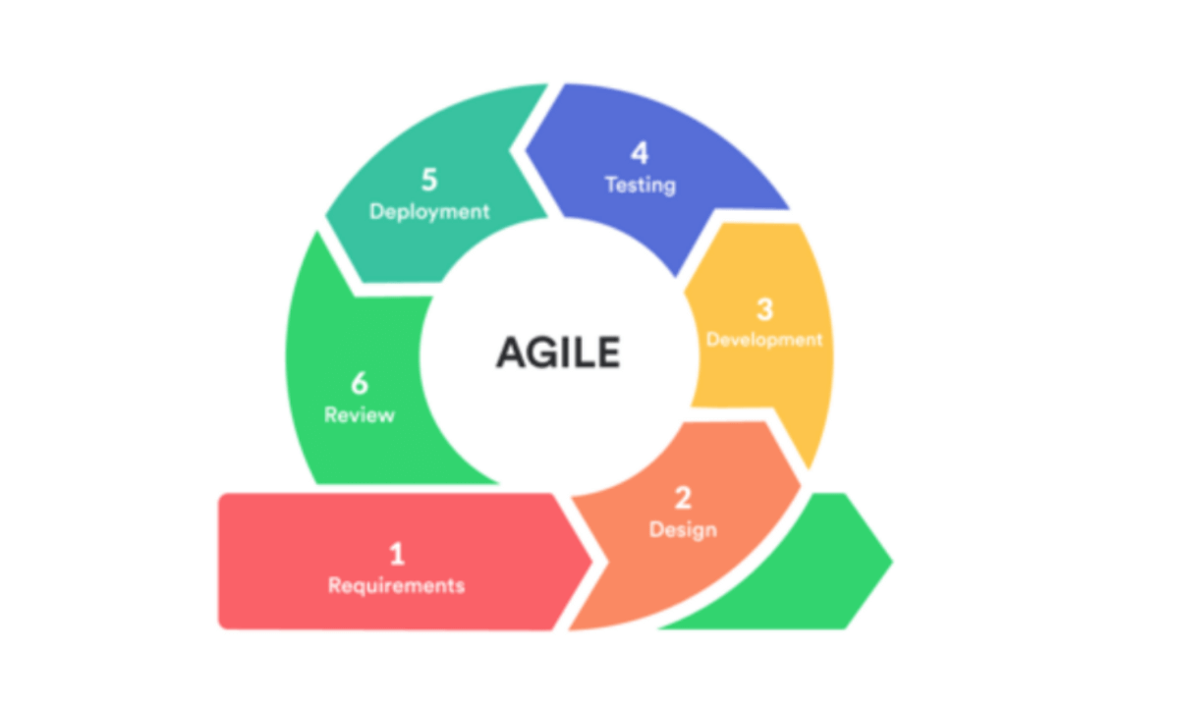
WHAT IS AGILE
It is an iterative / incremental model

Slide 4

AGILE PRINCLIPALS

Slide 5
Customer satisfaction by delivering the software early.
Accept the change requirement, even in the later stage of development.
Delivering the software frequently.
Daily cooperation between businesspeople and developers.
Projects are built around motivated individuals who should be trusted.
A face-to-face conversation is the best form of communication (co-location).
Working on the project rather than planning.
Sustainable development, able to maintain a constant pace.
Continuous attention excellence and better design.
The maximizing of the work efficiency.
Best design, the best solution, and architecture emerged from self-organizing.
Regularly meeting to discuss the team’s improvement.

Slide 6
ADVANTAGES OF AGILE
Requirement changes are allowed in any stage of development.
Release will be faster .
Customer no need to wait for long time.
There will be Good communication between team ( development , QA , client)
It is easy model to adopt.

Slide 7
DISADVANTAGE OF AGILE
Less focus on design and documentation since we delivery software very faster.
Sometimes in Agile methodology the requirement is not very clear hence it’s difficult to predict the expected result

Slide 8



Team
ABC
BAC
CBA
DEVELOPER
QA
CUSTOMER/CLIENT

Slide 9
SCRUM IN AGILE / SCRUM TEAM
Scrum is a framework through which we build software product by agile principals.
In the scrum there are set of team or people are involved that is called scrum team.
There are four types of peoples comes under the scrum team, they are
Product owner
Scrum master
Development team
QA team

Slide 10
PRODUCT OWNER :
Define the feature of the product.
Prioritize features according to market value.
Adjust features and priority every iteration, as needed
Accept or reject work results.
Scrum Master :
The main role is facilitating and driving the agile process.
Development / QA Team :
Development team develops the software.
QA will test the software.

Slide 11
Scrum Terminology
USER STORY
A feature / module in a software
EPIC
Collection of user stories
Product Backlog
Contains list of user stories, prepared by product owner.
Sprint
Period of time to complete the user stories, decided by the product owner and team.

Slide 12
Sprint planning meeting:
Meeting conducts with the team to define what can be delivered in the sprint and duration.
Sprint backlog
Contains the list of committed stories by development and QA for specific sprints.
Scrum meeting
Every day we have 15 mins meeting with scrum master.
Sprint Retrospective meeting
Conducts meeting after completion of sprint. The entire team, including both the scrum master and the product owner should participate.
Story point
Rough estimation of user stories, will be given by developer & QA in the form of Fibonacci series

Slide 13
Log a Defect for Login Functionality
Step 1: Select a project
Step 2: Select Issue type (Bug)
Step 3: Summary (Example)
Login functionality is not working properly
Step 4: Description (Example)
After Entering invalid Email Id and Password as we click Login button, we are getting face book home page but as Expected it should not be navigated to face book Home page.

Slide 14
Steps to reproduce
Open Facebook Application
Provide invalid Email Id and Password
Click on Login button
Expected: User should not be able to navigate Facebook Home page
Actual: We are getting Facebook home page
Step 5: Select Priority
Step 6: provide the Environment
Step 7: Attach screenshot or video
Step 8: Assign the place for Assignee (who going to work on next process)

Slide 15
Thank You
MALATHI V
2081139

